Slide 1
FINAL PROJECT • WEEK-6 AI-ML INTERNSHIP • FINANCE DOMAIN
Enhancing Fraud Detection Using
Synthetic Transactions Generated by Gen AI
An honest test on the real Kaggle dataset — including when the technique does, and doesn't, clearly help
Prepared by: Prayas Palit, Data Science & AI Intern Internship Provider: Global Next Consulting India Pvt. Ltd. (GNCIPL) Dataset: Genuine Kaggle Credit Card Fraud dataset (284,807 transactions)

Slide 2
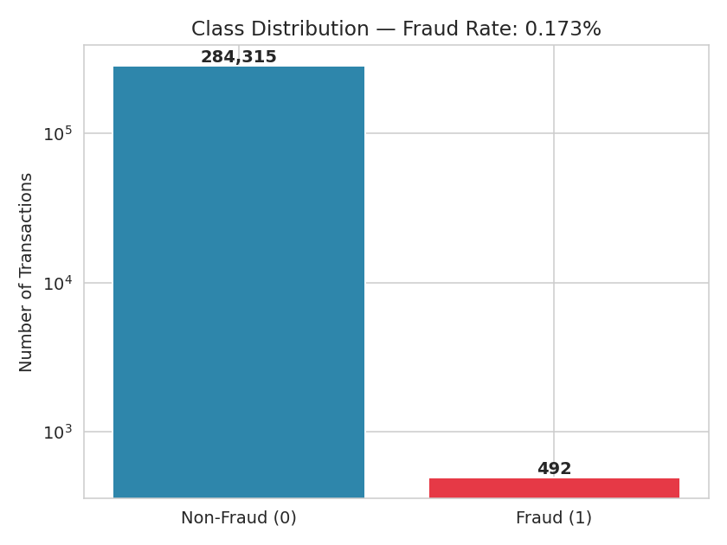
The Challenge
Fraud is a needle in a 284,807-transaction haystack
0.173%
The real question
This deck doesn't just test whether Gen-AI augmentation helps — it tests WHEN it helps, honestly.
of transactions are fraud
1 : 577
fraud-to-legitimate ratio
344
Figure: class distribution, log scale (492 fraud / 284,807 total)
real fraud rows available for training
Enhancing Fraud Detection Using Synthetic Transactions | GNCIPL AI-ML Internship
2

Slide 3
Our Approach
Leak-free at every stage — the generator and the classifier both stay blind to test data
1
2
3
4
Split First
Fit Generator on Training Fraud Only
Sample Synthetic Fraud
Augment & Evaluate
Real data split into train/test before anything else happens. Test set: 85,443 rows, 148 fraud.
Gaussian Copula learns from the 344 training-split fraud rows — never the 148 held-out ones.
5,000 new, statistically realistic fraud transactions — generated, not copied.
Real (train) + synthetic train the classifier; evaluation always uses the untouched real test set.
Enhancing Fraud Detection Using Synthetic Transactions | GNCIPL AI-ML Internship
3

Slide 4
Results: A Real Trade-Off, Not a Clean Win
Same model, same hyperparameters — evaluated on an identical, 100%-real, held-out test set
+6.8 pp recall
Catches 10 more of 148 real frauds (112 → 122) — but at a cost, see right
–12.7 pp precision
F1 actually dips slightly (−1.8 pts) — this is a trade-off, not a clean win
Enhancing Fraud Detection Using Synthetic Transactions | GNCIPL AI-ML Internship
4

Slide 5
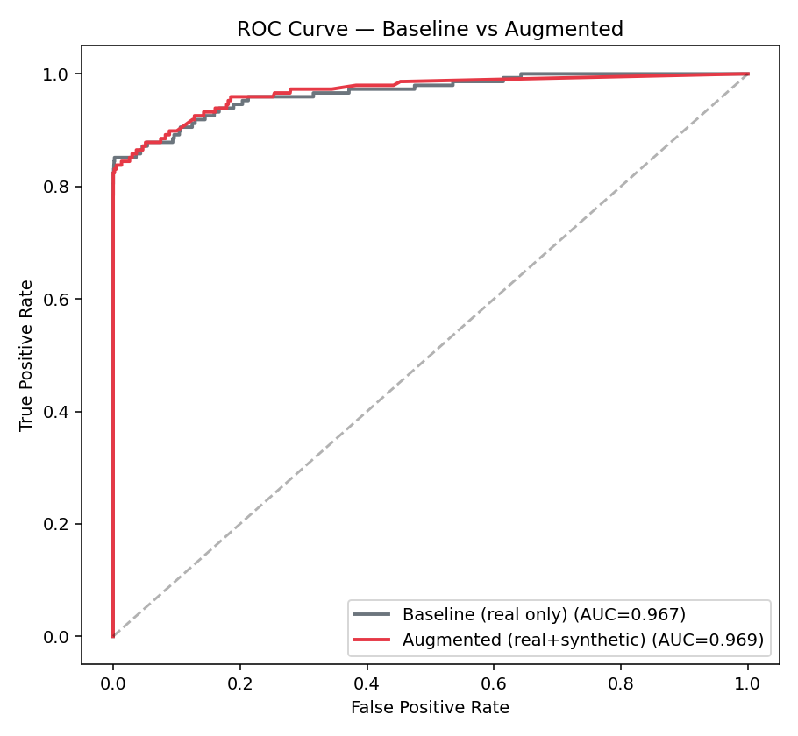
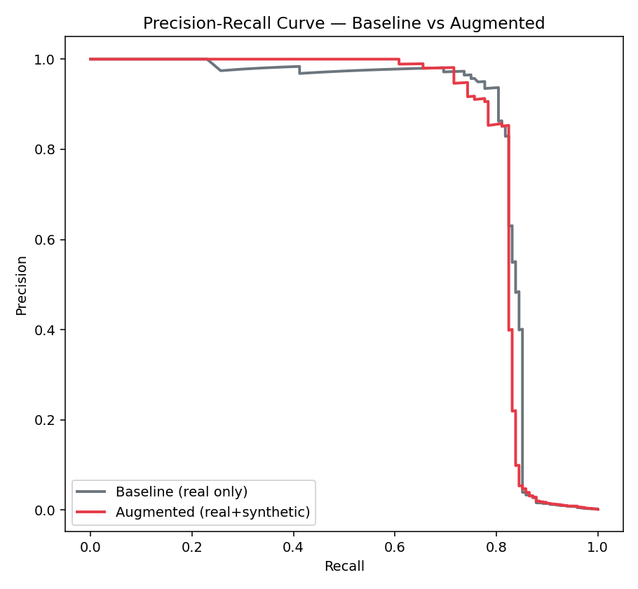
A Fairer Comparison: Matched Thresholds
Comparing default thresholds can mislead — a model tuned toward recall will show higher recall by construction
At matched precision/recall:
Recall @ P=0.957: Base 0.757 | Aug 0.716 Precision @ R=0.757: Base 0.957 | Aug 0.913 Average Precision: Base 0.822 | Aug 0.819
Honest finding: at matched operating points, the two models are essentially a wash — marginally favoring the baseline. Augmentation mainly shifted the default threshold's position, not the model's underlying discriminative power.
Enhancing Fraud Detection Using Synthetic Transactions | GNCIPL AI-ML Internship
5

Slide 6
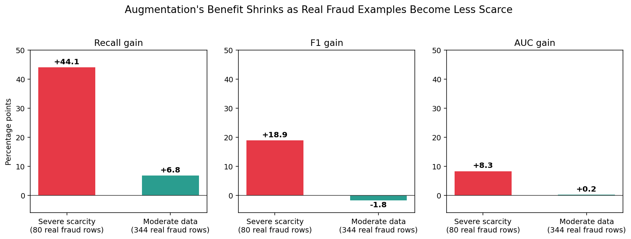
The Key Insight: Scarcity Changes Everything
Same technique, same pipeline — tested under two real-data-scarcity conditions
80 rows
Severe scarcity: recall +44.1 pts
344 rows
Moderate data: recall +6.8 pts, F1 roughly flat
Practical rule of thumb: reach for synthetic augmentation aggressively when real examples number in the tens. Once real examples number in the hundreds, validate carefully before trusting it — the benefit may be marginal.
Enhancing Fraud Detection Using Synthetic Transactions | GNCIPL AI-ML Internship
6

Slide 7
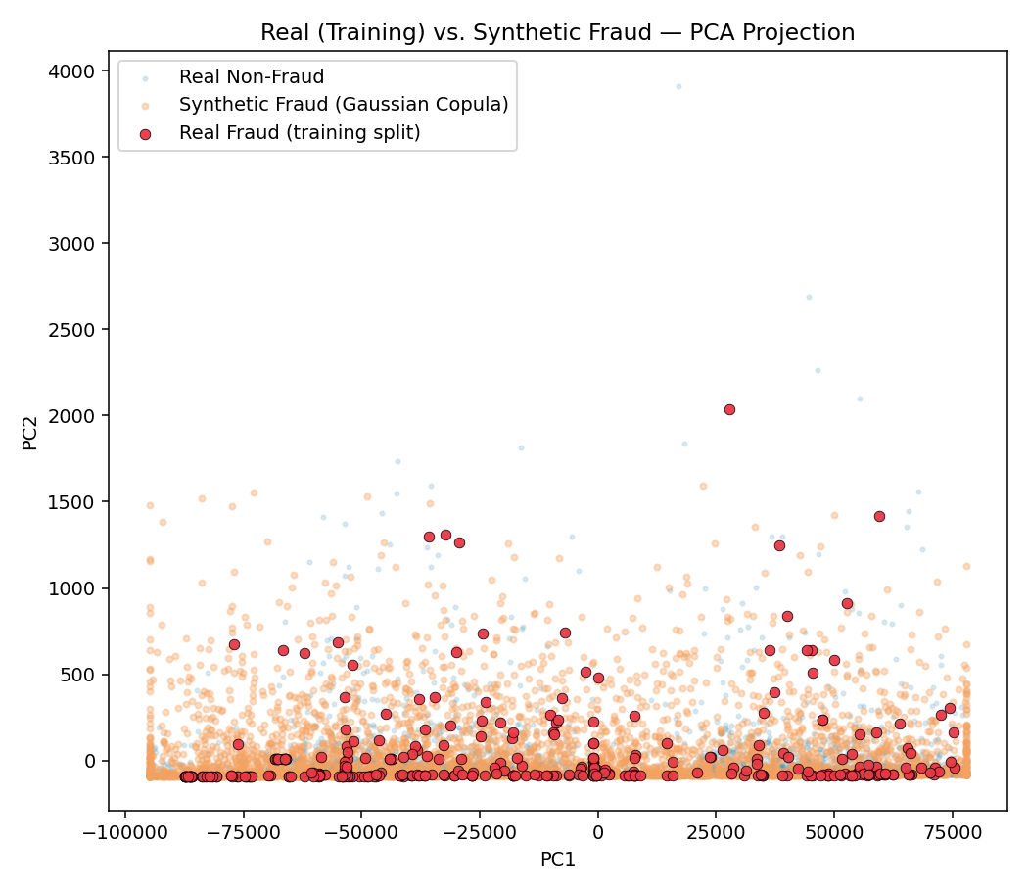
What the Augmented Model Actually Catches
Confusion Matrix — Test Set (85,443 real transactions, 148 fraud)
Baseline (real only)
Augmented (real+synthetic)
 | Pred: Non-Fraud | Pred: Fraud
Actual: Non-Fraud | 85290 | 5
Actual: Fraud | 36 | 112
 | Pred: Non-Fraud | Pred: Fraud
Actual: Non-Fraud | 85270 | 25
Actual: Fraud | 26 | 122
Reading it: 10 more real frauds caught (122 vs 112), but 20 more false alarms raised out of ~85,000 legitimate transactions. Whether that trade is worth it depends on the business's actual cost of a false positive vs. a missed fraud — tune the threshold accordingly rather than assuming augmentation is a free win.
Synthetic fraud (orange) lands inside the real fraud cluster (red), not scattered noise.
Enhancing Fraud Detection Using Synthetic Transactions | GNCIPL AI-ML Internship
7

Slide 8
Business Impact
Guidance on WHEN to Use This
Recall Upside Where It Counts
Most valuable early on, with little real fraud history. Re-evaluate — don't assume — as real data accumulates.
Still catches 10 more real frauds per 148 — useful if a missed fraud costs more than a false alarm.
Data Compliance
Avoided a Costly False Conclusion
Synthetic generation reduces reliance on additional real, sensitive customer records either way.
Rigorous, leak-free, matched-threshold testing prevented reporting a misleadingly rosy result.
Enhancing Fraud Detection Using Synthetic Transactions | GNCIPL AI-ML Internship
8

Slide 9
Risks & Recommendations
RISKS & LIMITATIONS
RECOMMENDATIONS
Gaussian Copula used in place of CTGAN — worth retesting with true CTGAN given how close the moderate-data result was
Random Forest depth capped at 16 for training speed on a single-core sandbox
Only one generative technique tested; marginal-fit outliers were found and corrected (V8)
Moderate-data scarcity finding is a single dataset/run — not yet confirmed elsewhere
Precision drops alongside the recall gain at the default threshold
Use augmentation confidently under severe scarcity (tens of real rows); validate carefully once real examples reach the hundreds
Test true CTGAN/TVAE (via sdv) against Gaussian Copula where disk/GPU budget allows
Tune the decision threshold to the real cost of a false positive vs. a missed fraud
Always fit generative models on the training split only — never on held-out data
Report matched-threshold and PR-AUC results, not just default-threshold metrics
Enhancing Fraud Detection Using Synthetic Transactions | GNCIPL AI-ML Internship
9

Slide 10
Conclusion
Tested rigorously on the genuine Kaggle dataset, Gaussian-Copula augmentation gave a modest, mixed result at 344 real fraud examples (+6.8 pts recall, roughly flat F1, essentially unchanged Average Precision) — a real trade-off, not a clean win.
284,807
real transactions analyzed
Leak-free
The more valuable finding: comparing against an earlier severe-scarcity run (80 real rows, +44.1 pts recall) shows this technique's benefit depends heavily on how much real data already exists — concrete, evidence-based guidance on when to actually use it.
at every pipeline stage
2 regimes
tested: severe vs. moderate scarcity
Thank you — Questions welcome

